Slide 1

COVID-19 DETECTION IN CHEST X-RAYS
(Olugbenga Abdulai, Kinjal Kachi, Sujay Puvvadi)

Slide 2
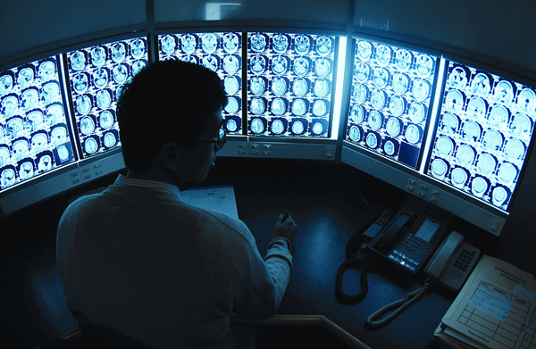

Background
Radiological images continue to grow at a significant rate compared to the number of trained radiologists available.
It is estimated, that in some cases, an average radiologist must interpret one image every 3–4 seconds in an 8-hour workday to meet workload demands
AI-driven radiological image analysis has the potential to increase efficiency & reduce errors by providing trained radiologists with, in many cases, superior detection capabilities.

Slide 3

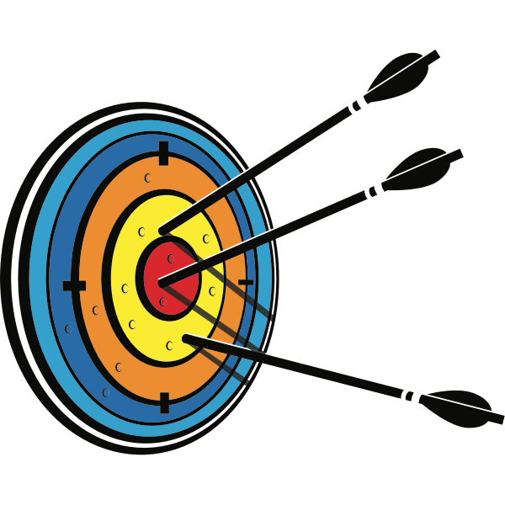
Goal
The goal that deep learning aims to achieve in radiologic image analysis is two-fold; time savings and accuracy in disease detection.
A comparison of deep learning performance against health-care professionals in detecting diseases from medical imaging: a system
The coronavirus disease (COVID-19) is a respiratory illness that affects the lungs of patients and causes difficulty breathing amongst other symptoms
Achieve COVID-19 detection in chest X-ray data

Slide 4
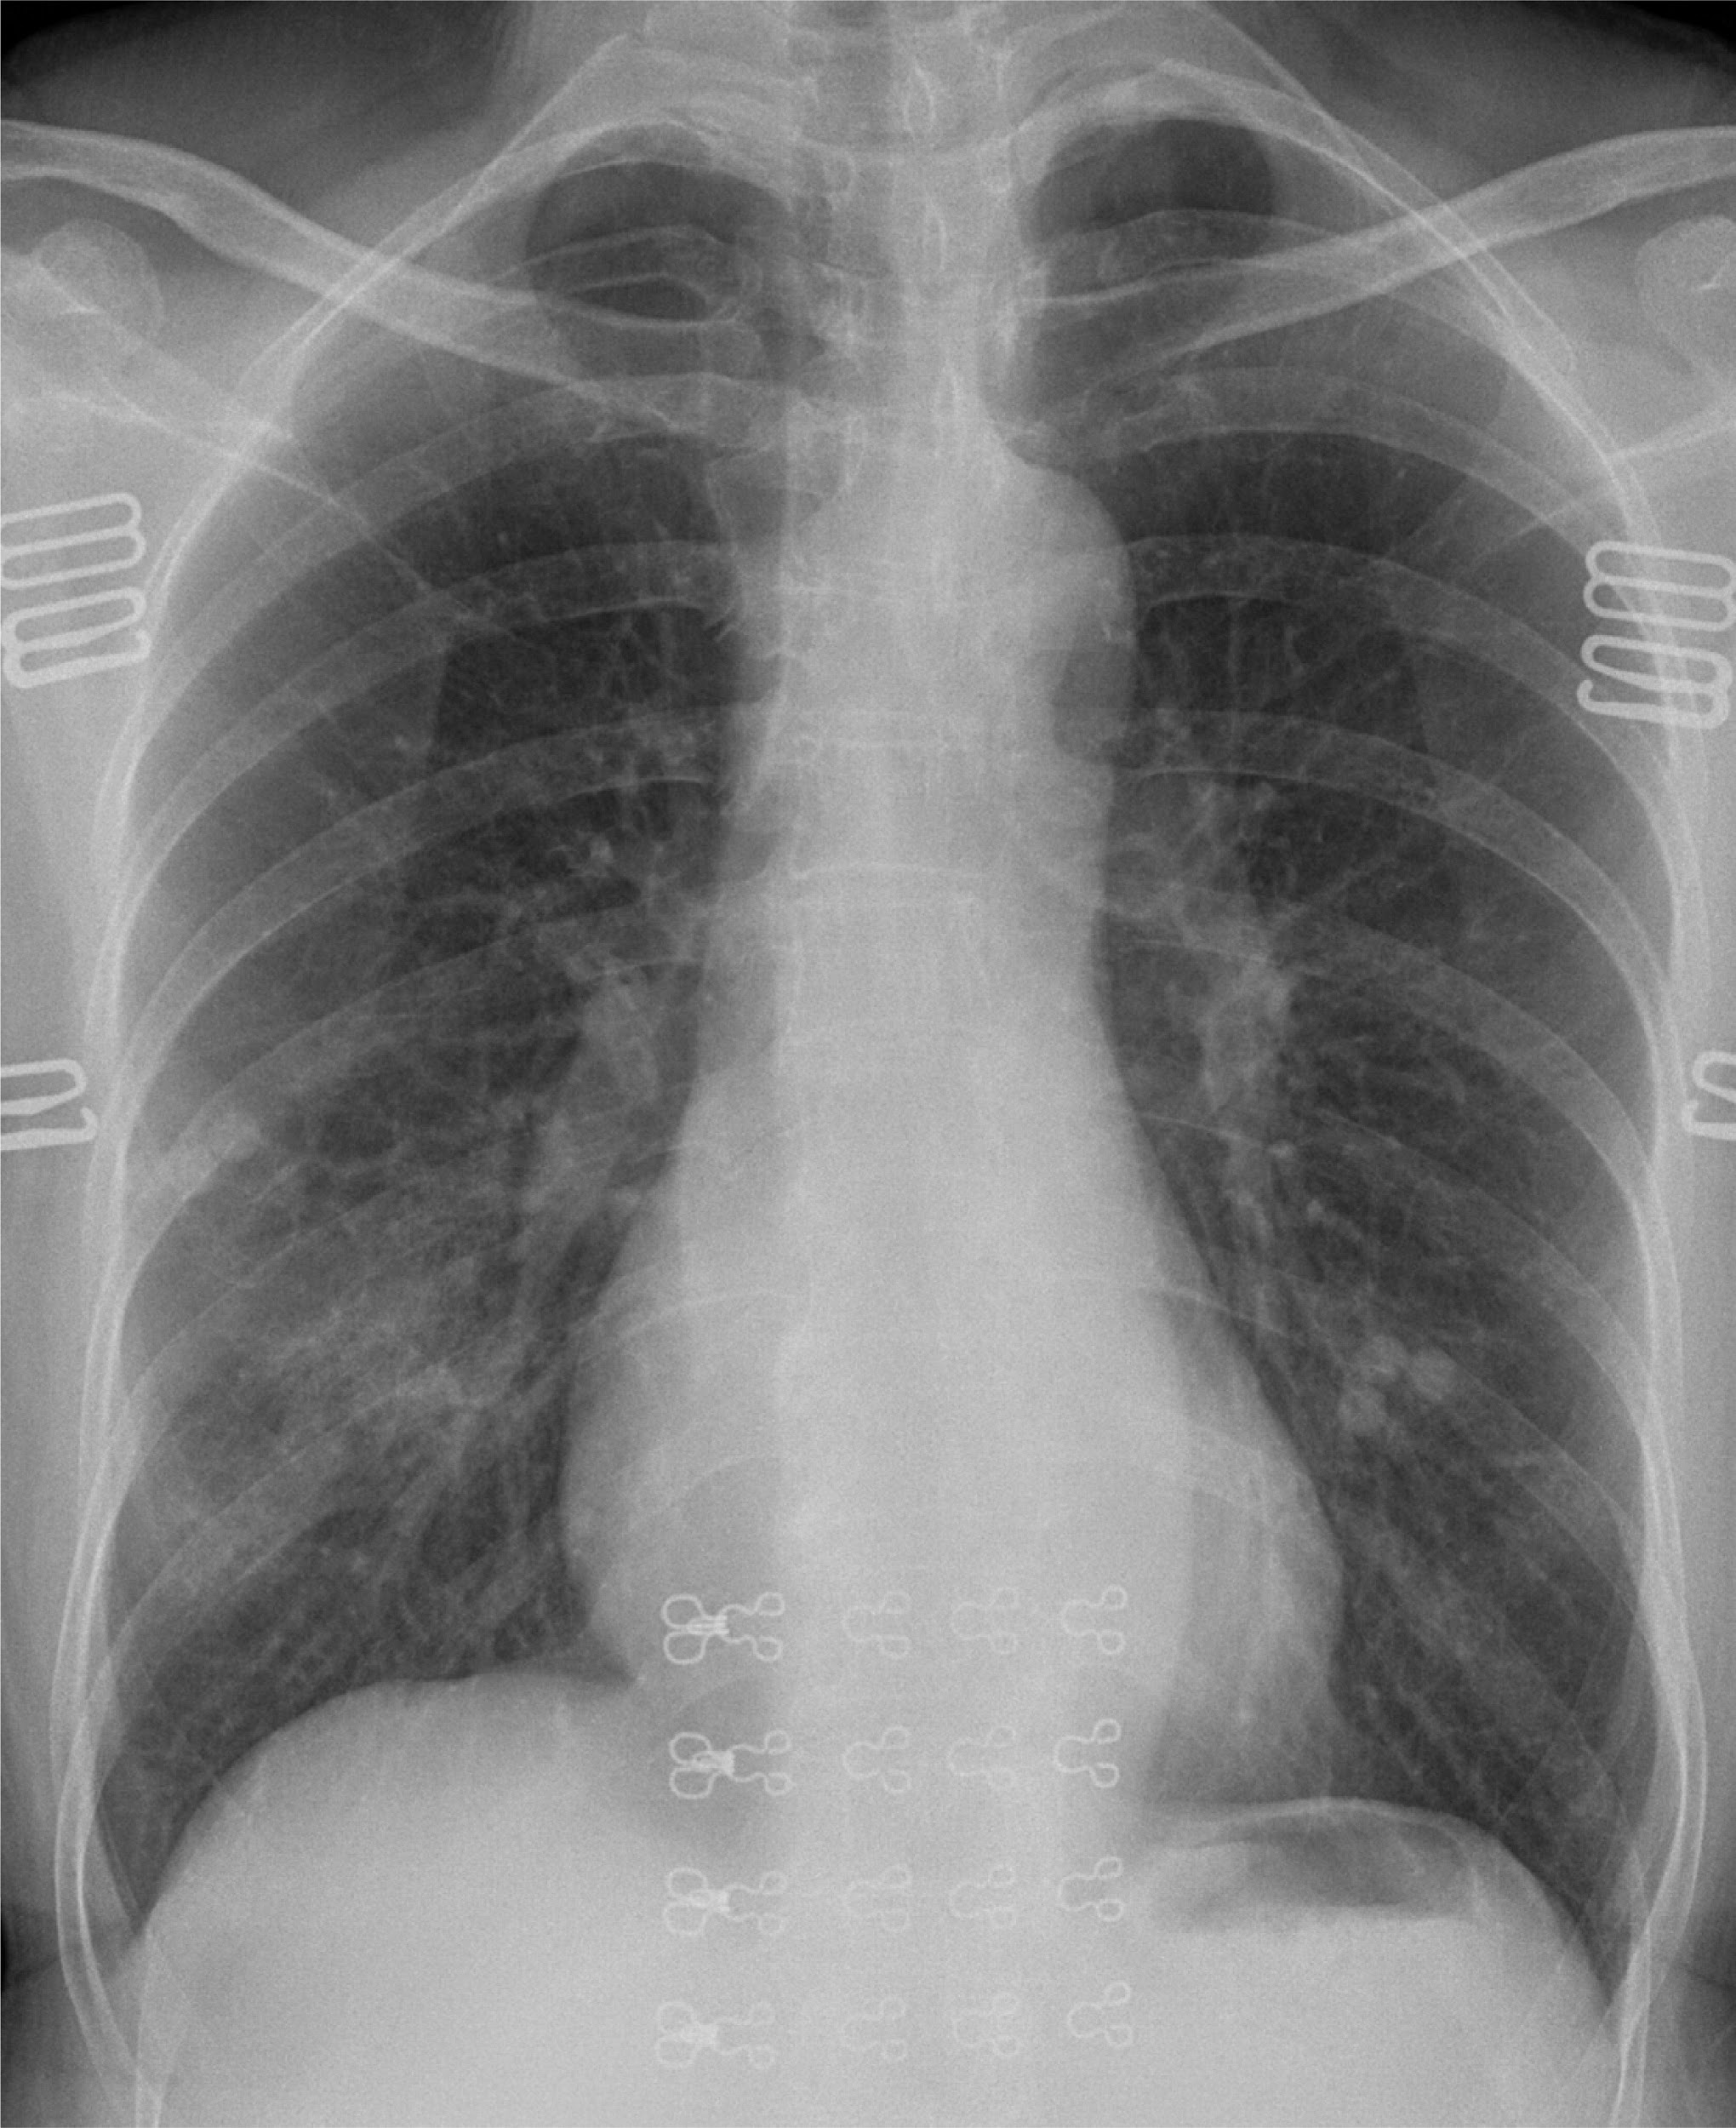
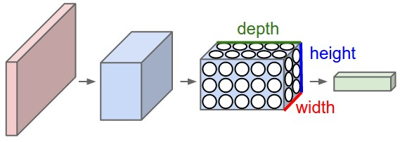
Solution
Computer Vision with deep learning to assist disease detection and research
Convolutional neural networks
Possible extensions to similar domain problems
COVID ?
Viral Pneumonia ?
Normal ?

Slide 5
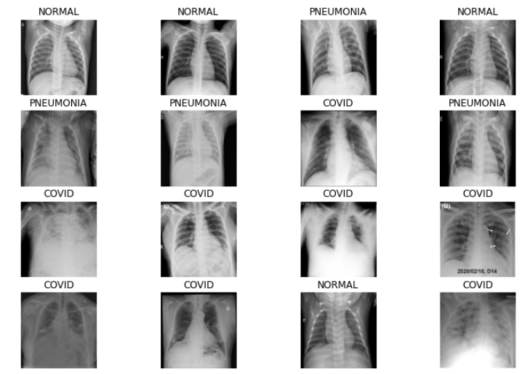
Dataset
The dataset was sourced from Kaggle datasets but originally compiled by a team of researchers and medical doctors in Asia.
It consists of chest x-ray images each belonging to one of 3 classes - COVID, normal, and viral Pneumonia.
Sample images from dataset displayed on the right

Slide 6
Project flow
Exploratory data analysis
Image preprocessing
Base model build
~99%
Model deployment
Model selection and refinement
Reporting

Slide 7
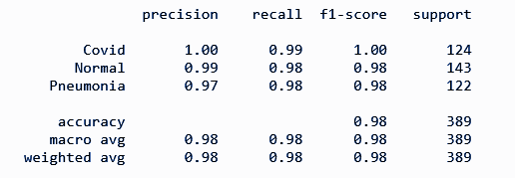
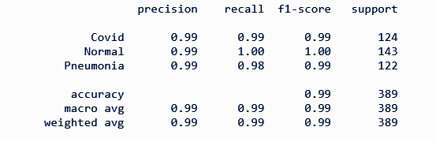
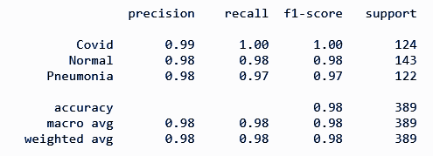
Results
Base model
Xception
Inception-ResNet

Slide 8

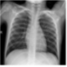
The network
GradCAM
What’s happening under the hood of the convolutional neural network?
Intermediate feature maps

Slide 9
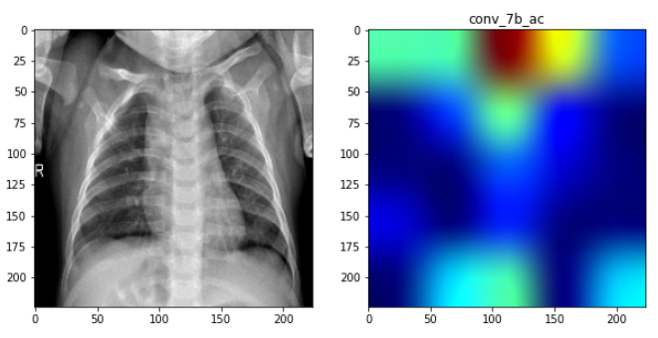
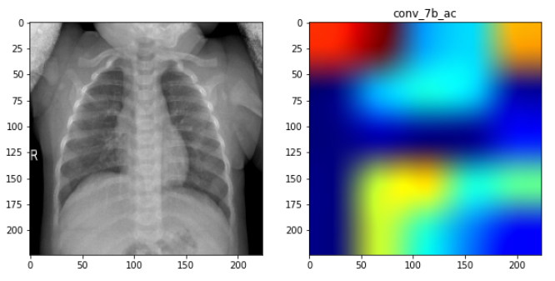
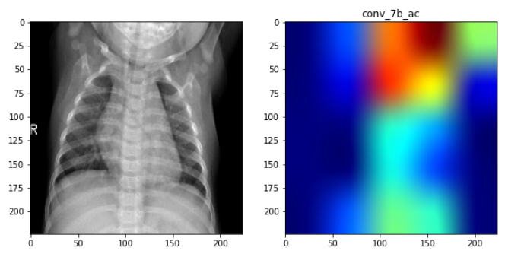
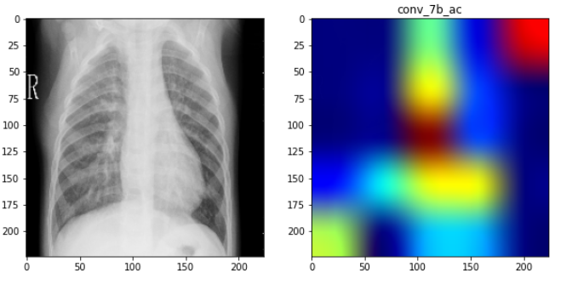
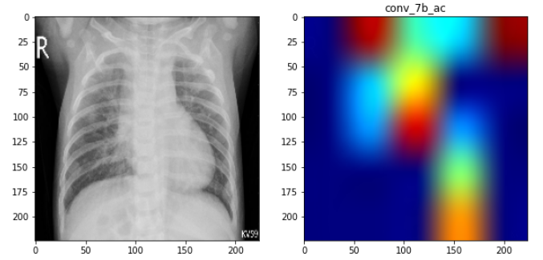
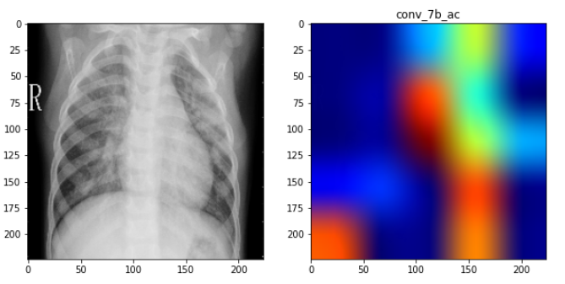
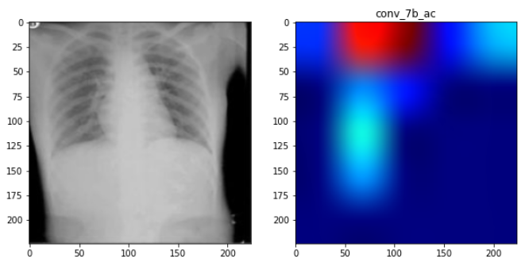
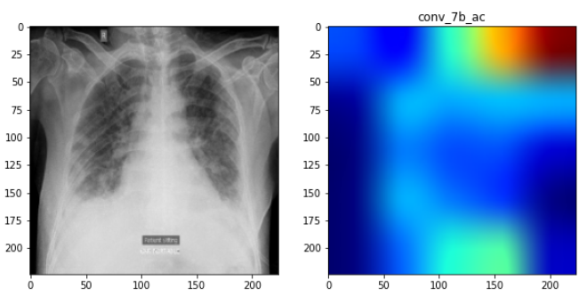
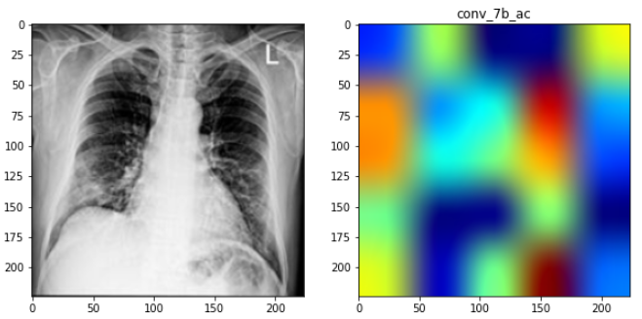
The network
GradCAM Output
Normal Images
Pneumonia Images
Covid Images

Slide 10
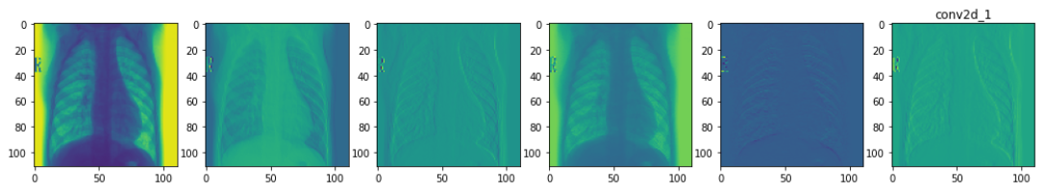
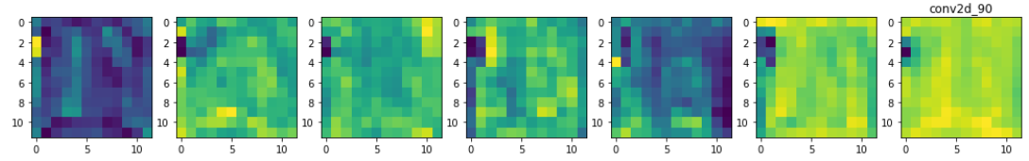
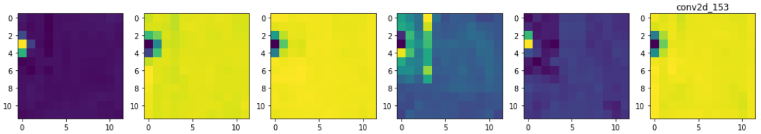
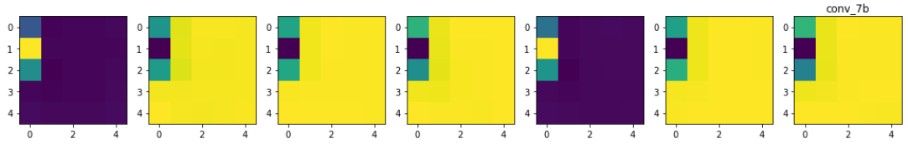
The network
Intermediate feature maps - Pneumonia
Convolutional Layer 1
Convolutional Layer 90
Convolutional Layer 153
Final Convolutional Layer

Slide 11
Final Product
This website is a three-page static website. We have used Flask to serve static files because it is a great choice for building web applications in a modular way using Python. To deploy our final model as a web application, we used Flask alongside web design tools like HTML and CSS. It has features such as scroll-up, scroll-down, and anchoring.
Running the application
Run the model_deployment.py in your terminal.
The website will be up and running on the server http://127.0.0.1:5000/.
The three page website looks as below.

Slide 12
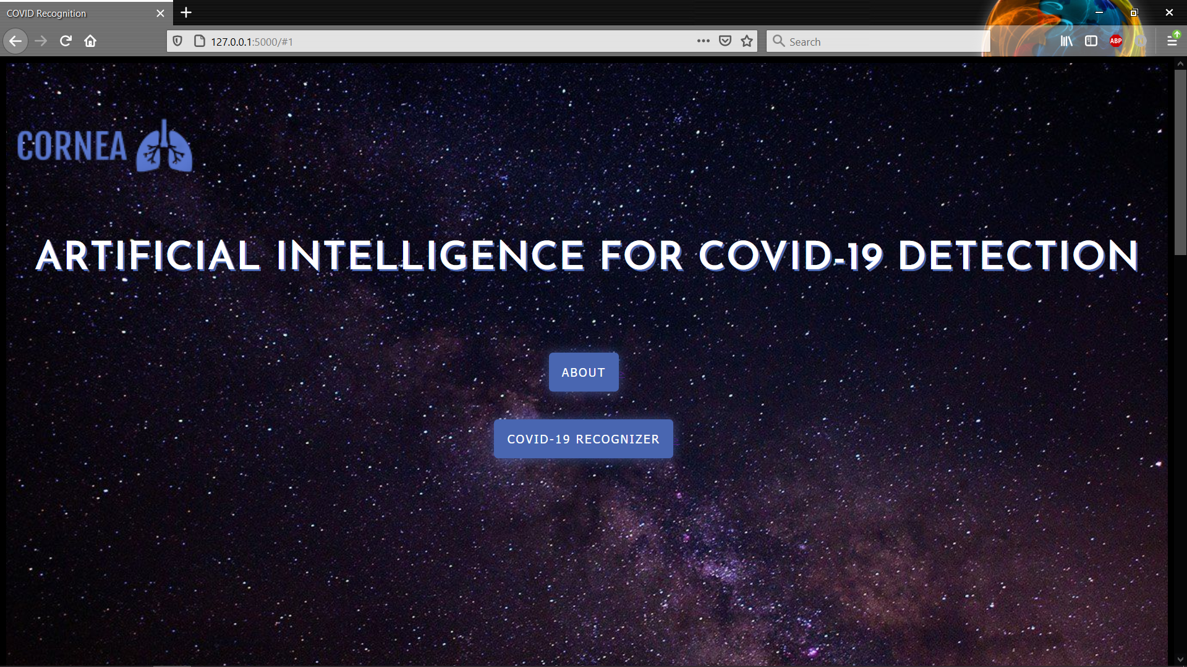
Home page

Slide 13
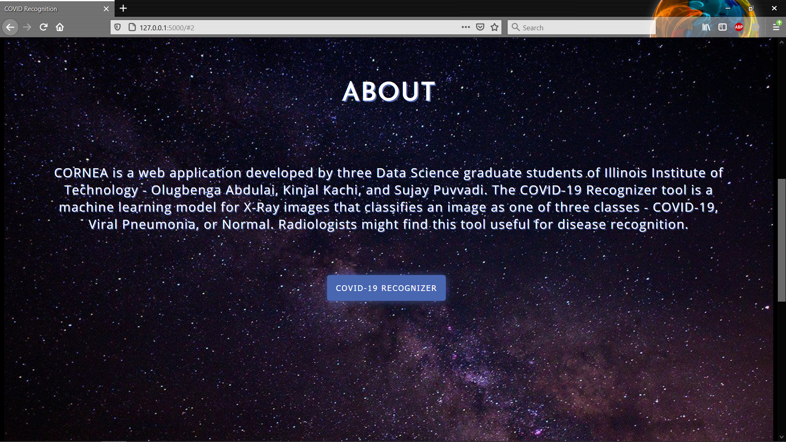
About Section

Slide 14
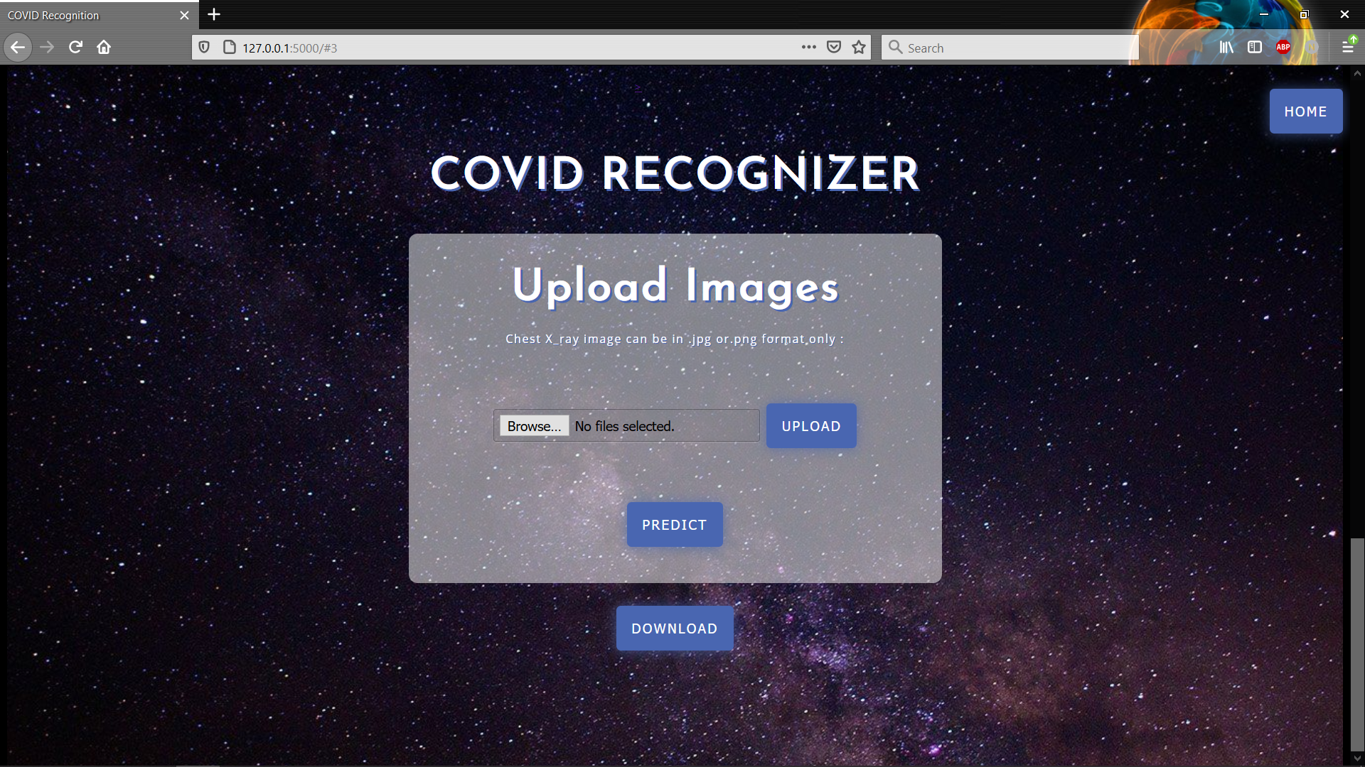
Classifier

